Slide 1
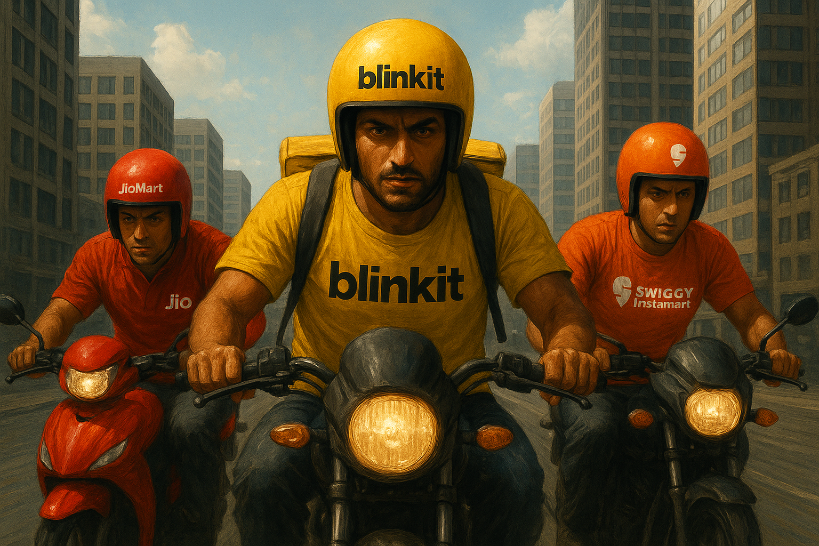
Quick-Commerce Unveiled
1 Lakh Orders Reveal Who Wins on Speed, Loyalty & Market Share

Slide 2


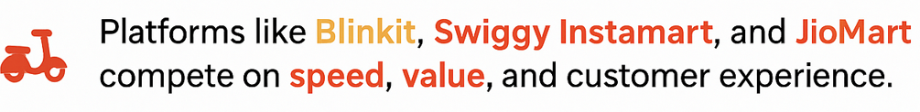
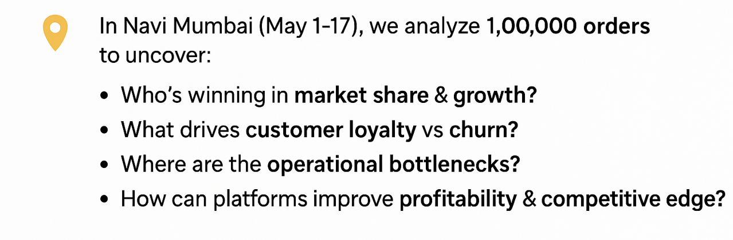
Why This Analysis Matters

Slide 3



Dataset Overview
Source: Kaggle Dataset (curated to reflect quick-commerce order patterns in Navi Mumbai, May 2025)
Coverage: 1,00,000 orders placed in Navi Mumbai ( May 1 – 17 2025 )
Purpose: Benchmark performance of Blinkit, Swiggy Instamart, and JioMart across customer, revenue and operations metrics
Key Fields
> Order ID— Unique order identifier
> Customer ID— Unique customer identifier
> Platform— Blinkit/Swiggy Instamart/JioMart
> Order Date & Time— Timestamp of order
Delivery Time (Minutes) — Time taken to deliver
> Product Category— Item category ordered
> Order Value (INR) — Total order amount
> Service Rating— Rating score (1–5)

Slide 4
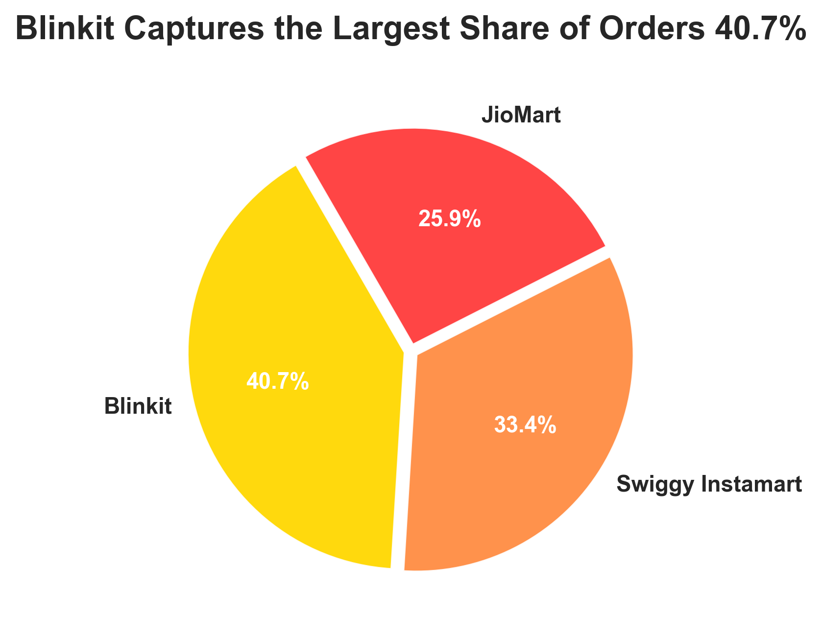
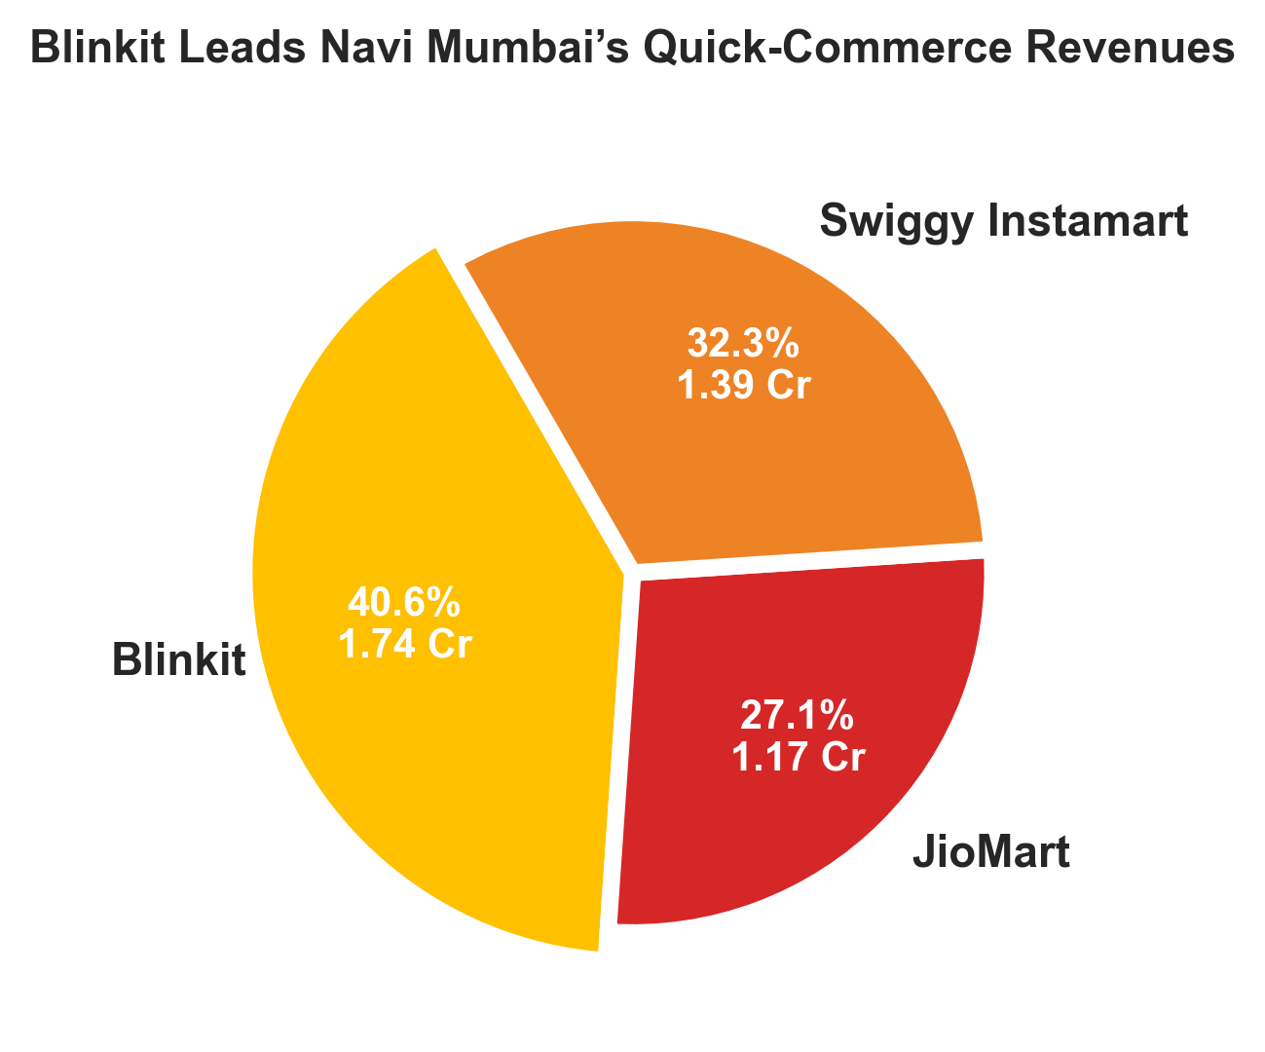
Market Split: Orders vs Revenue Share Across Platforms
Blinkit leads with 40.7% orders / ₹1.74 Cr revenue → volume + value leader.
Instamart holds 33.4% orders / ₹1.39 Cr revenue → fewer orders, strong basket size.
JioMart at 25.9% orders / ₹1.17 Cr revenue → lagging scale, moderate value

Slide 5
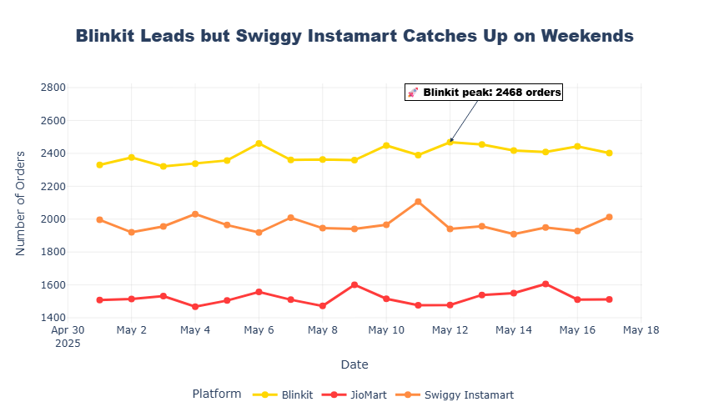
Daily Trend: Orders Across Platforms ( May 1 – 17 )

Slide 6
Efficiency & Value: Average Order & Delivery Performance
Platform | 💵 Avg Order Value | 🛵 Avg Delivery Time | ⚠️ SLA Breach ( 15 min )
Blinkit | ₹429 | 13 min | 🟡 13% (Moderate)
Swiggy Instamart | ₹415 | 11 min | 🟢 11% (Low)
JioMart | ₹451 | 17 min | 🔴 52% (Very High)
Blinkit leads in speed and value, Instamart stays efficient
JioMart lags with delays despite higher order value

Slide 7
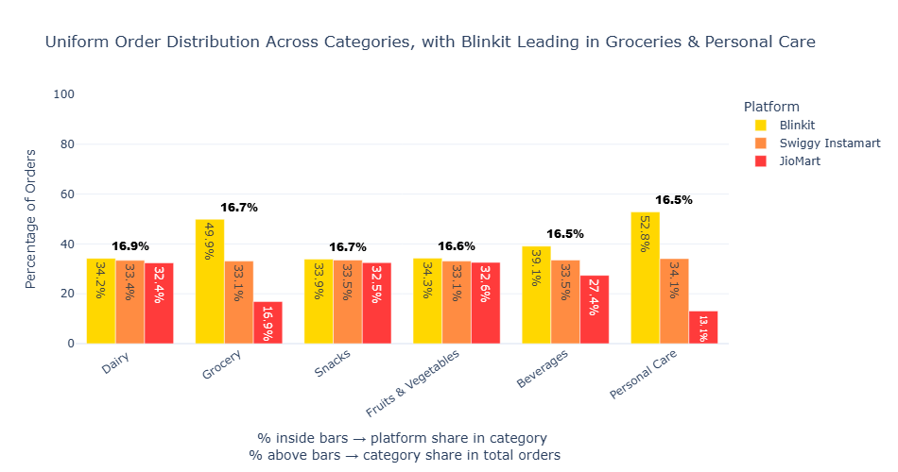
Revenue & Volume Leaders by Product Category
Revenue Leaders
Personal Care → 22%
Beverages → 18%
Grocery → 18%
Together: 60% of total revenue
Blinkit dominates; Swiggy maintains consistent 33%+ share across categories

Slide 8
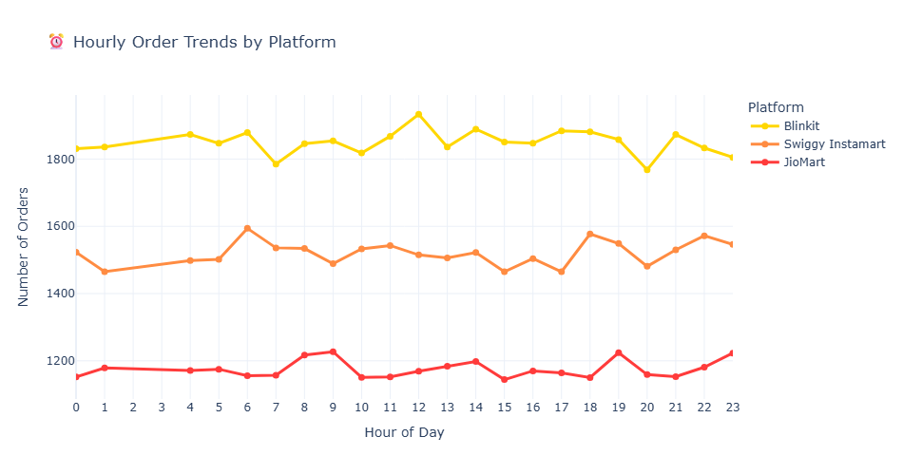
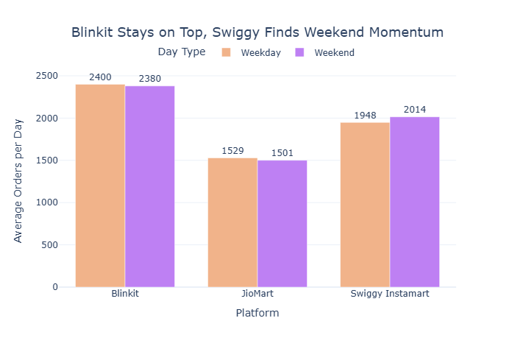
When do they order?
All platforms: ~66–67% orders on weekdays, ~33% weekends → consistent weekday dominance across Blinkit, Instamart, JioMart
JioMart: Spike +10.9% @19:00, strong morning & evening peaks +9.4% & +8.0%
Swiggy Instamart: Evening/Night spikes +6–7%
Blinkit: Stable; small AM bump +4.9%

Slide 9
Customer Segmentation Breakdown
Platform | 💚Loyalist | 💰 Price-Only | 🔵 Promisable | ⚠️ At-Risk
Blinkit | 25% (10,055) | 72% (29,258) | 1% (360) | 3% (1,022)
Swiggy Instamart | 25% (8,416) | 71% (23,882) | 1% (299) | 3% (852)
JioMart | 22% (5,599) | 75% (19,283) | 1% (167) | 3% (807)
Price-only buyers dominate (~71–75%) → discount-driven. Loyalists (~22–25%) form revenue backbone, need retention.

Slide 10
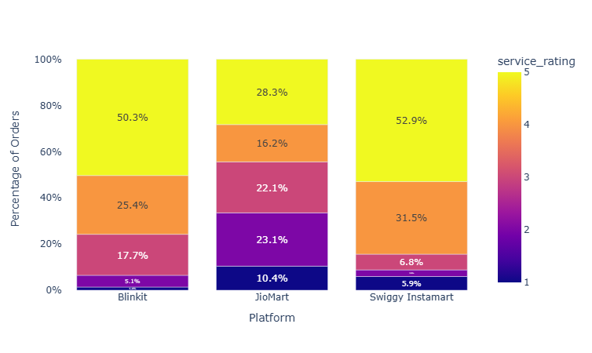
Who Wins in Customer Satisfaction?
Blinkit leads in orders and revenue, but Swiggy Instamart wins the trust 84% satisfied vs Blinkit’s 75%.
Blinkit Leads in Sales, But Swiggy Wins Hearts ❤️

Slide 11


Ratings are driven by SPEED
We analyzed what drives customer ratings across platforms
By performing regression analysis, we found that:
Delivery Time is the only significant driver of ratings.
Other factors like cost or product category had no measurable impact.
Every +10 min delay → rating drops by ~1.1 points.
🏆This is why Swiggy Instamart has the most satisfied customers
Fastest deliveries in the industry (Avg = 11 min)
Customers get their orders before impatience sets in → higher ratings.
🕗=⭐

Slide 12
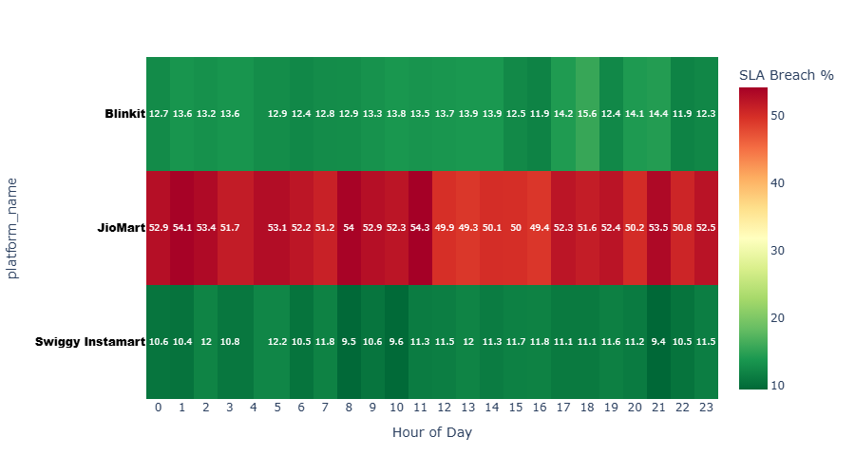
Pinpointing Delivery Delays: Where They Happen
Blinkit SLA breaches: 12–15% at 18:00–21:00 → evening bottleneck
Blinkit: Delays in Dairy 9.7% & Personal Care 9.9% → bulky/premium SKUs slow ops.
JioMart: Uniformly poor ~40–50% delays →no delivery promises
Swiggy: Balanced delays 8–9% delay rate → consistent ops
Swiggy SLA breaches stay 10–12%, dipping to ↓9.4% at 21:00.
Even with 40% night orders, operations remain fast and satisfaction high

Slide 13
Beyond Order Volume: What Truly Drives Platform Revenues
Metric | Winner 🥇 | Middle ⚖️ | Lagging 📉 | Key Takeaway
Total Revenue | Blinkit (₹1.74 Cr) | Swiggy (₹1.39 Cr) | JioMart (₹1.17Cr) | Blinkit leads topline
Customer Base (Unique) | Blinkit (8.9K) | Swiggy (8.8K) | JioMart (8.5K) | Blinkit has widest reach.
Order Frequency | Blinkit (4.6x) | Swiggy (3.8x) | JioMart (3.0x) | Blinkit drives loyalty & stickiness.
Average Order Value (AOV) | JioMart (₹451) | Blinkit (₹429) | Swiggy (₹415) | JioMart wins on basket value.
Category Contribution (Revenue Mix) | Blinkit → Premium skew 💄Personal Care 30%, 🛒 Grocery 20%, 🥛 Dairy 14%, 🥤Beverages 15% | Swiggy → Diversified mix 💄Personal Care 21%, 🥤Beverages 18% 🥛 Dairy 18% | JioMart → Essentials-heavy 🥤Beverages 23% 🥛 Dairy 22% 🥬Fruits & Veg 16% | Blinkit grows via premium categories JioMart via essentials Swiggy stays balanced but lacks a “hero” category.
Blinkit wins via scale + premium mix, JioMart via essentials, Swiggy via balance

Slide 14
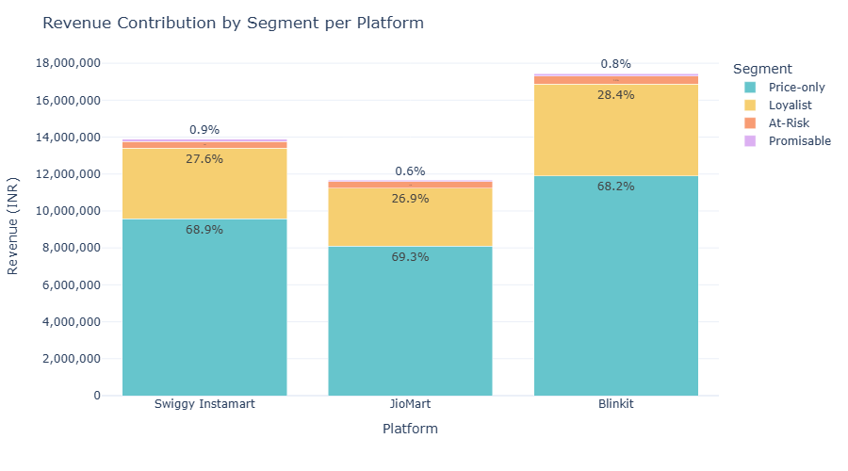
Loyalists, though smaller in number, are the backbone of revenue
Majority of revenue comes from Price-only and Loyalist segments (~72–75% + 22–25%)

Slide 15
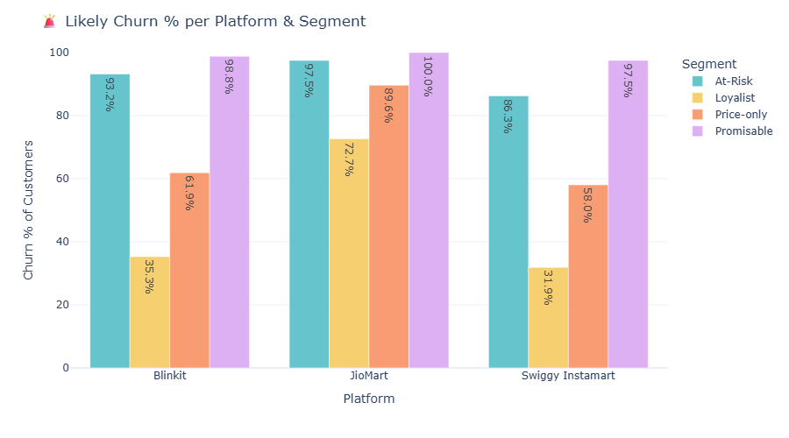
Customer Churn Insights & Strategic Focus per Platform
JioMart: High churn across segments → prioritize optimizing delivery times and targeted marketing.
Blinkit & Swiggy Instamart: At-Risk/Promisable contribute <5% revenue → focus on Loyalist and Price-Only segments with targeted discounts, offers, and marketing campaigns to maximize retention and revenue.

Slide 16
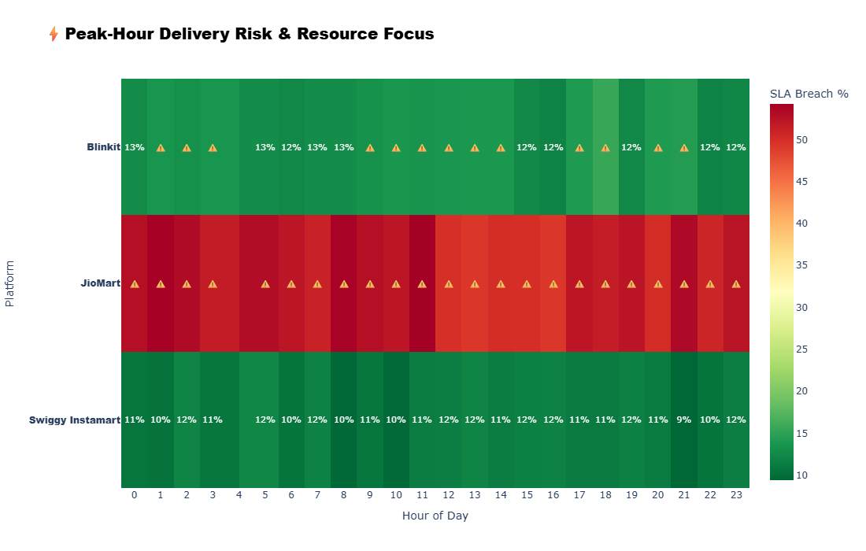
Blinkit and Jiomart hit ⚠️ hours → focus resources here to reduce breaches and protect ratings.
Swiggy maintains <13% delay all day → high customer satisfaction.

Slide 17
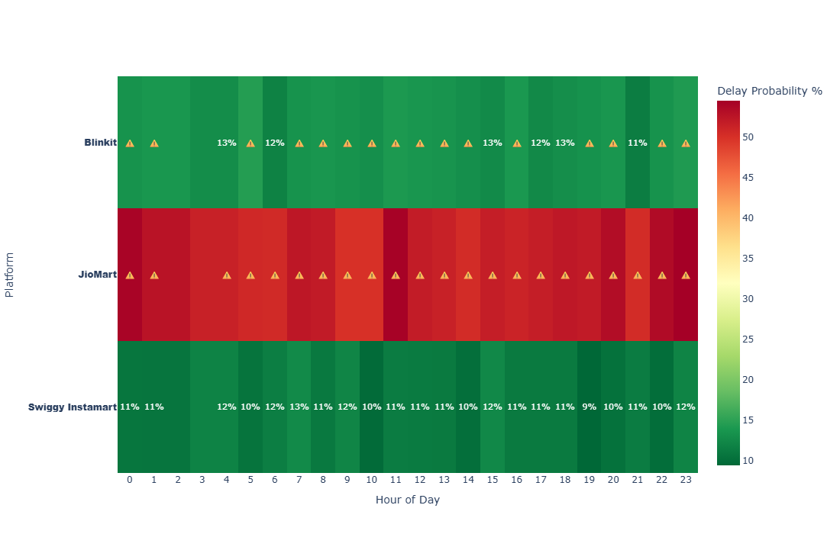
Predicting Delivery Delay Likelihood Across Platforms
Blinkit’s rising warning probability signals the need for immediate resource reallocation to prevent SLA breaches.
JioMart has allocate it’s resources and do more planning to reduce Delivery Time
Swiggy shows zero delay warnings, highlighting strong operational stability.

Slide 18
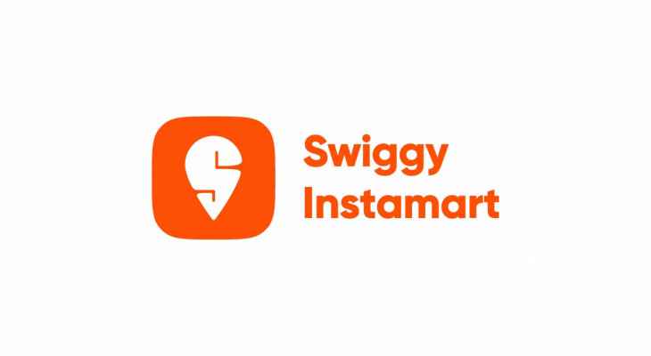


Faster Deliveries → Stronger Ratings & Lower Churn
Every 10-min delay = ⭐ rating drop of 1.1 Fixing delivery time is the fastest path to customer satisfaction
(⭐ 85% Satisfied) ✅ Already the fastest (Avg 11 mins, p95: 15 mins). → Maintain consistency; double down on marketing & reach expansion. → Clear path to overtake Blinkit in revenue leadership.
Blinkit (⭐ 75% Satisfied) ⚠️ Delay clusters (morning 9–14h, evening 20–21h). → Targeted resource allocation in these cohorts could lift satisfaction closer to Swiggy. → Unlocks stronger competitive moat if delay dips <12%.
(⭐ 45% Satisfied) 🚨Chronic delays across all hours; biggest gap to close. Speed gains = ratings boost (high elasticity: -1.1/10 mins). With highest Avg Order Value, improving delivery speed unlocks loyalty and lowers churn in price-sensitive segments.

Slide 19
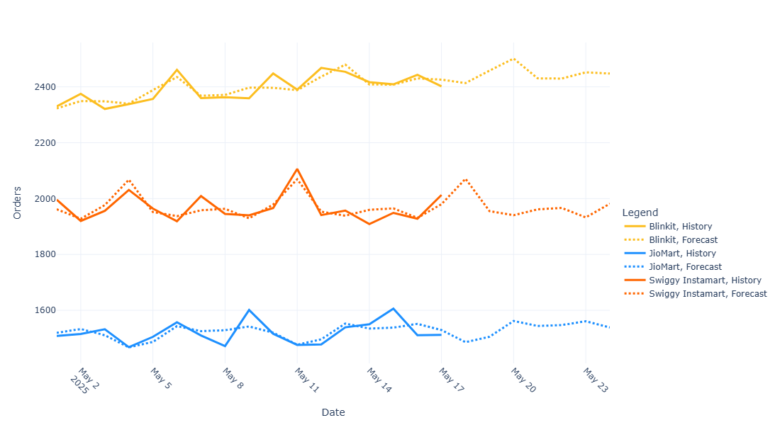
📈 7-Day Forecast of Daily Orders Across Platforms
Swiggy Instamart is projected to see a sharp weekend spike
Blinkit shows a steady upward Trend
JioMart is projected to remain largely stable

Slide 20
Market Leader with Operational Gaps
Strengths
Market leader in orders & revenue (~40%+ share).
Strong loyal customer base (25%).
75% customer satisfaction, competitive but behind Swiggy.
Recommendations
Resource optimization during peak delay cohorts.
Targeted discounts & offers for price-sensitive buyers.
Personalized retention campaigns for loyalists to reduce churn
Converting 50% of “Price-Only” customers into Loyalists has the potential to lift Blinkit’s total revenue by 7.3%, unlocking significant top-line growth.
Weaknesses
Delivery delays in multiple cohorts (morning, afternoon, evening).
Only 74% customers satisfied vs. Swiggy’s 85%.
72% price-only buyers → highly discount dependent.
Higher churn probability in non-loyal segments.

Slide 21
Operational Excellence, Growth Needed
Strengths
Fastest average delivery time: 11 mins.
0% delay warnings across all hours.
Highest satisfaction rate: 85% (4+ ratings in 85% of orders).
Strong in weekend spikes & late-night orders → operationally flawless.
Recommendations
Focus on customer acquisition to expand market share.
Strengthen loyalty programs to boost retention.
Upsell/cross-sell to increase basket value.
If Swiggy Instamart increases AOV from ₹415 → ₹450 and retention by 1 order per customer (3.8x → 4.8x), revenue would rise by 37% uplift
Weaknesses
Lower market share & revenue than Blinkit
Smallest basket value among platforms.
Order frequency per customer: 3.8x vs. Blinkit’s 4.6x.

Slide 22
High Value, High Risk
Strengths
Highest average basket value across platforms
Contributes ~27% of revenue despite smaller market share.
Strong in beverages, dairy, and fruits categories.
Customer base nearly equal to Swiggy Instamart (~8.5K vs. 8.8K).
Recommendations
Urgent focus on reducing delivery time (17 → 15 mins) → ratings could rise from 3.0 to 4.0.
Improve churn management with personalized offers.
Leverage high basket value customers with premium loyalty plans.
By reducing average delivery time from 17 min to 12–13 min, JioMart can raise ratings by ~0.6 points, cut SLA breaches to below 20%, and lower churn by nearly half unlocking an estimated 8–12% revenue upside.
Weaknesses
Longest avg delivery time: 17 mins → severe SLA breaches.
Only 45% customers satisfied.
Churn >70% in most segments.
Lowest order frequency: 3x per customer.

Slide 23
Conclusion & Next Steps
Key Recommendations:
Optimize Resource Allocation: Prioritize Blinkit’s delivery performance improvement (reduce delay likelihood).
Leverage Forecasting: Use demand forecasts to adjust staffing & inventory, especially for Swiggy’s weekend surges.
Enhance Customer Experience: Focus on reducing delivery time variability to increase retention across all platforms.

